Slide 1
Current knowledge about Nordic welfare issues

Slide 2
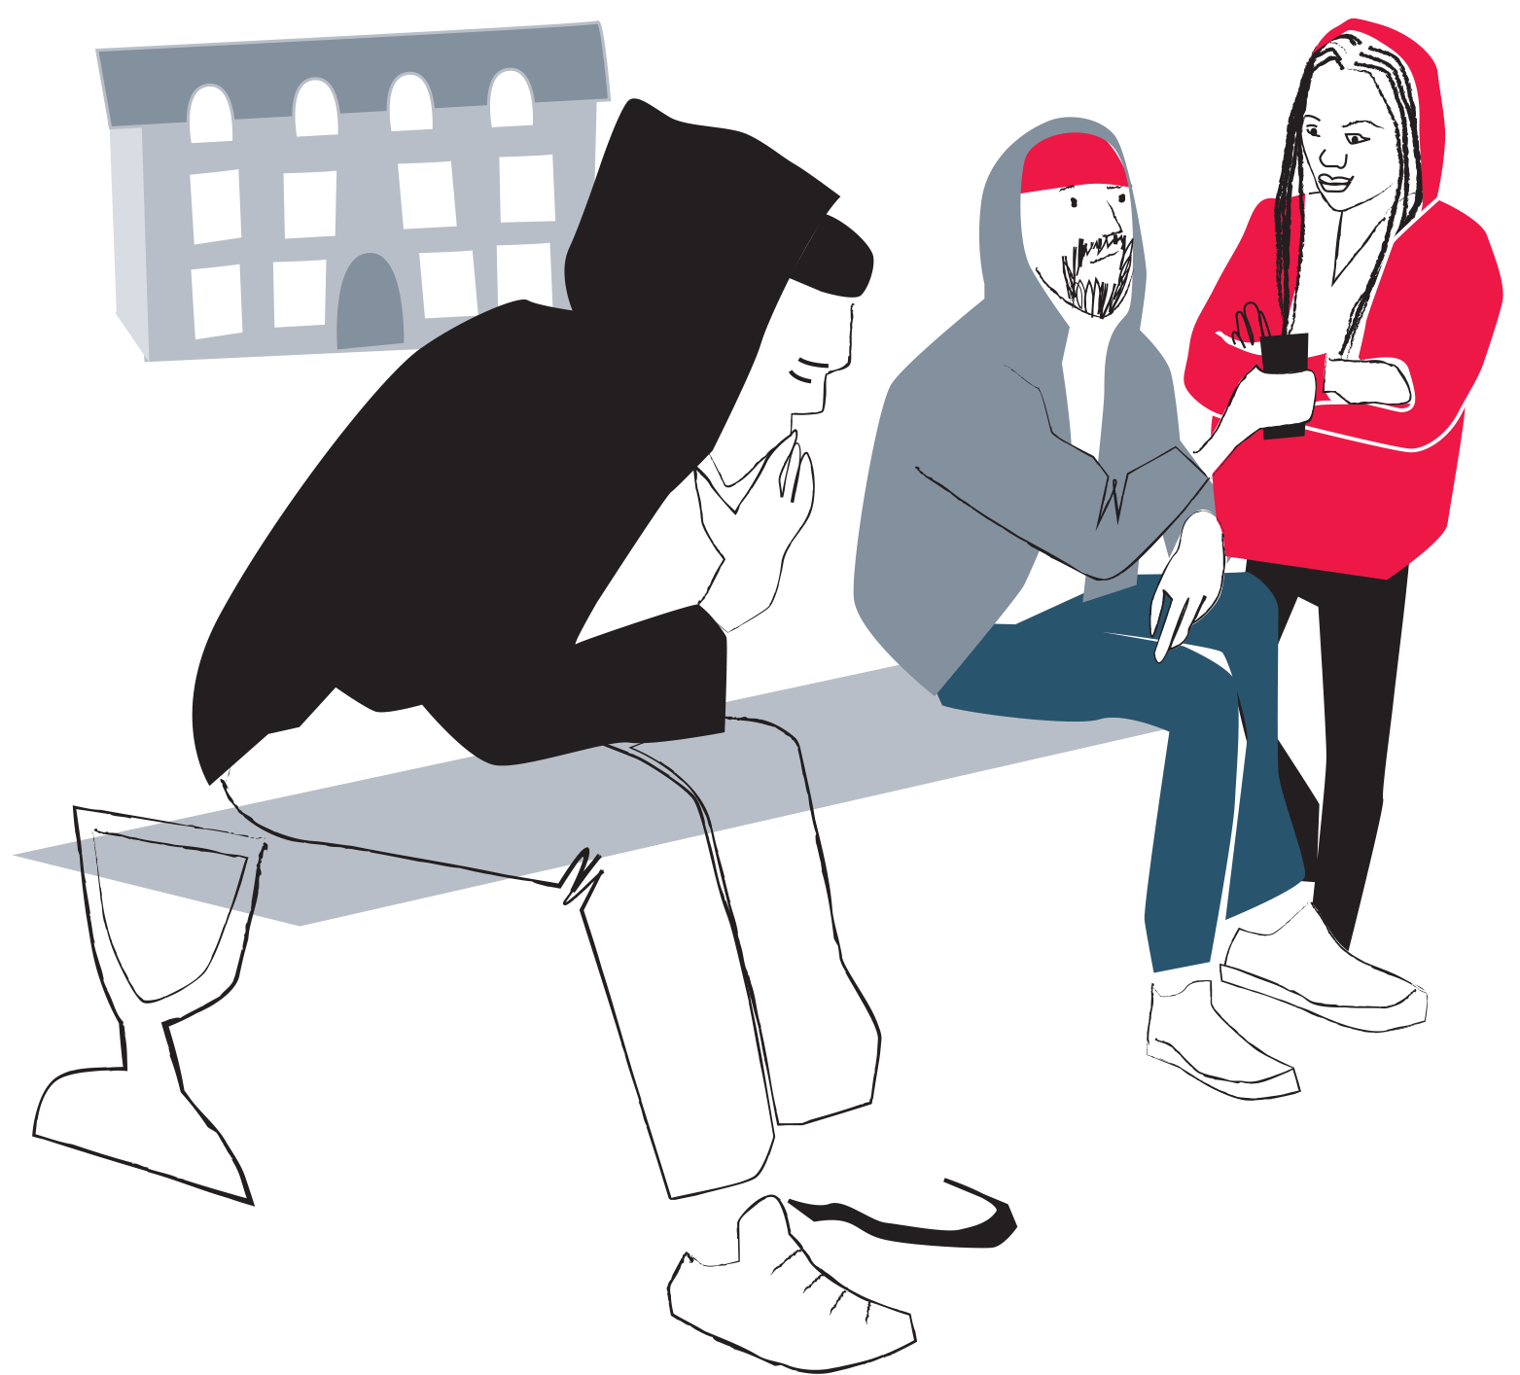
NEETs, projects and measures: Baltic Sea Region in the European Social Fund Flagship School to work – Integrating NEETs

Slide 3
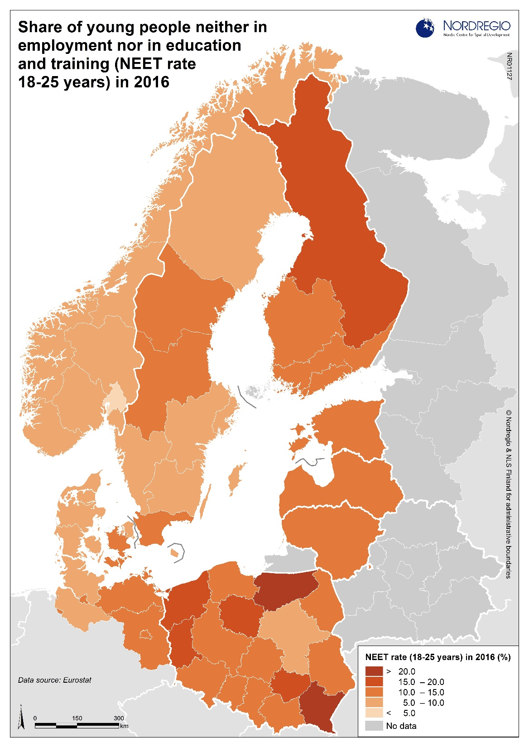

Slide 5
Success factors from projects and other measures aiming to improve life conditions among youth
Youth perspective and influence
Multi-professional teams
Large and flexible tool-box
Approach and commitment
Holistic perspective
Individual support
Focus on strengths and possibilities

Slide 6
The Youth perspective:
Listen to young people
Help us to find a direction
Help us to succeed
What are our rights and obligations
We want to be a part of a context
Treat us with respect and give us a secure foundation

Slide 7
Thank you! www.nordicwelfare.org Facebook: Nordens välfärdscenter Twitter: @Nordicwelfare1 Lidija.k-soderlund@nordicwelfare.org
Notes:
Feel free to mention that the audience can find more information on our website and follow us on our social media channels. And that they shouldn’t hesitate to reach out to us if they have further questions.

